Slide 1




Building a Web Application with JavaScript:
Planning Your App and Setting up the Project

Slide 2

Tools Used to Develop a JavaScript Web App
Deciding on a Runtime for a JavaScript App
Describing the Files We Will Create for the JavaScript App
Demo: Creating the File/Directory Structure for a JavaScript App
Initializing a Node.js Project for the JavaScript App
Demo: Initializing a Node.js Project for the JavaScript App
Overview

Slide 3
Tools Used to Develop a JavaScript Web App

Slide 4

Tools Used to Develop a JavaScript Web App
IDEs and Editors
Software for devs used to build apps, it combines common dev tools into a single GUI & tool, has a source code editor, terminal, build automation tools, debugger, & source control integration: VS Code, Atom, Eclipse, Sublime Text
Frameworks
A structure to hold applications: Angular, Express, Emberjs, VueJS, React
Package Managers
Software that installs, upgrades, configures, & removes packages maintained in repositories: npm, yarn, gulp
Libraries
A collection of functions to perform an operation for quick implementation. Used for animations, data visualization, data handling, user interface 7 more:
mocha, socket.io, webpack, jQuery
Used to maintain the quality of code, readability of code, identify structural problems, & discover ugly syntax errors:
ESLint, Prettier, Flow
Linting

Slide 5
Top 5 IDEs
 | Rank (as of Aug 2022) | IDE | Share | Trend
 | 1 | Visual Studio | 28.24 % | -0.4 %
 | 2 | Visual Studio | 12.73 % | +1.4 %
 | 3 | Eclipse | 12.65 % | -1.4 %
 | 4 | Android Studio | 9.04 % | -0.4 %
 | 5 | pyCharm | 8.45 % | +0.4 %
Code
Source: Top IDE index: https://pypl.github.io/IDE.html

Slide 6
Deciding on a Runtime for a JavaScript App

Slide 7

What Is a Runtime?
A runtime is a program or environment that can execute code
A runtime for JavaScript is anything that can interpret & execute JavaScript code & provide features as well as capabilities for it
Think of a runtime as a layer between your code and the hardware or software that runs it taking care of translating your code into instructions that the underlying system can understand and execute
The runtime also handles errors, memory management, security, and other aspects of running your code

Slide 8



Runtimes for JavaScript
JavaScript code may be executed in one of two runtime environments:
A browser is a runtime environment
A browser can provide a runtime for JavaScript. It has built-in objects and functions that you can use to manipulate the web page, access the network, handle events, etc.
A Node is a runtime environment
JavaScript is not limited to web browsers, it can also run on other platforms, such as Node.js. Node.js is a runtime for JavaScript on servers. Node.js has its own set of objects & functions that can be used to create web apps, access databases, work with files, etc.

Slide 9
Describing the Files We Will Create for the JavaScript App

Slide 10

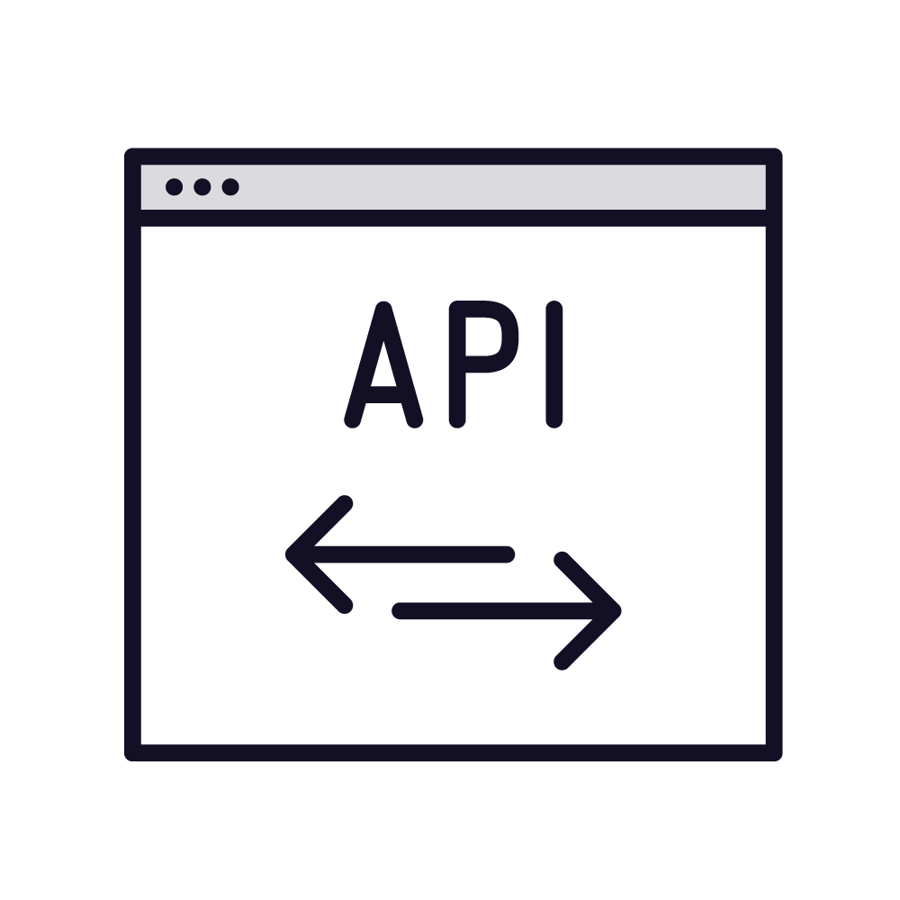


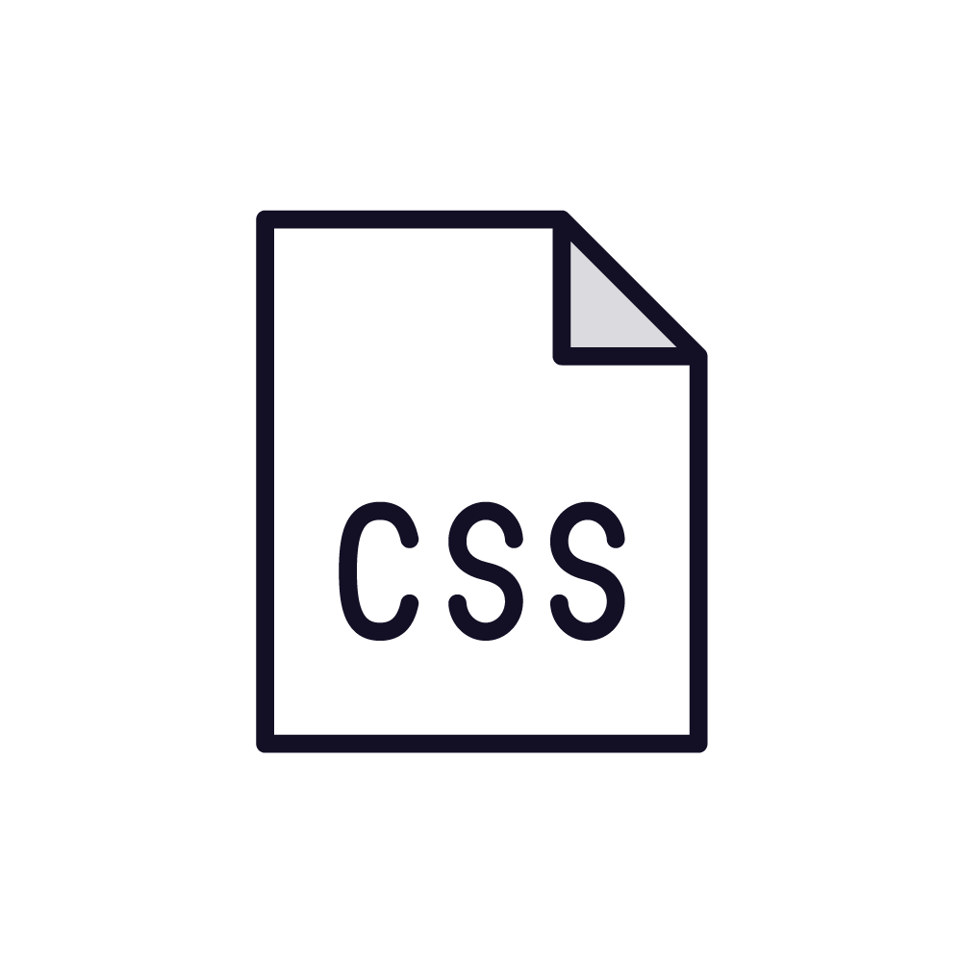

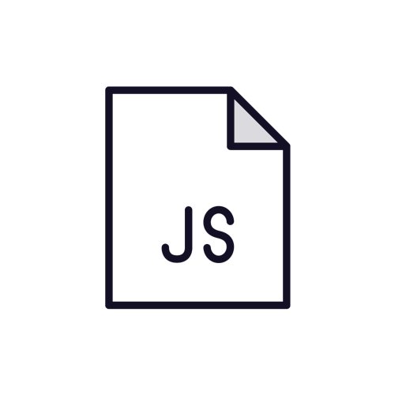
Basic JavaScript Web App Architecture
User Interface
API of web app
MySQL Database
Back end of web app
Front end of web app

Slide 11
app/
- config/
features/
feature1/
feature1.html
feature1.js
feature2/
feature2.html
feature2.js
views/
index.html
-index.js
Feature Based File/Directory Structure for Our
Web App

Slide 12
#Create directories, sub directories, and files for our web app
sudo -s mkdir -p app/{config,features/{addjoke,jokelist},views} && touch "app/index.js" "app/apiserver.js"
"app/config/dbinfo.js" "app/views/index.html" "app/features/addjoke/addjoke.html" "app/features/addjoke/addjoke.js" "app/features/jokelist/jokelist.html" "app/features/jokelist/jokelist.js"
Create Directories, Sub directories, and Files for our Web App
We can use bash to create our directories, sub directories, and files with a single command.

Slide 13

Demo
Demo: Creating the File/Directory Structure for a JavaScript App

Slide 14
Initializing a Node.js Project for the JavaScript App

Slide 15

To initialize a Node.js project, use ‘npm’ to generate the initial project
Do this by navigating to the project directory & run the following command `npm init’
This command will ask a series of questions & then create a ‘package.json’ file for the project
To skip the questions, use the ‘-y’ flag & automatically say “yes” placing the defaults in the ‘package.json’ file
Initialize a Node.js project

Slide 16
Demo
Demo: Initializing a Node.js Project for the JavaScript App

Slide 17
In this module we covered:
Explored the various tools developers use to build web apps in JavaScript
Decided on a JavaScript runtime for our web app
Built a general architecture for our JavaScript web app
Learned about initializing Node.js
And then we created the files, directories, and initialized Node.js for our project
Summary
Why this is important:?
This is the first step in building a web app with JavaScript. It is ideal to plan out the general architecture of your web app & plan the file/directory structure. Getting the file/directory structure correct up front will save you time later on so that you won't have to do re-work.

Slide 18

Up Next:
Building the Layout, Style, and CRUD for Your App with HTML and CSS

